Slide 1
2024 KICT-BIM Based Collaboration Platform - XR Based Quality Verification Report
VIRNECT QA Team
Sungtae Kim
March 14, 2025

Slide 2
Revision History
VIRNECT Co., Ltd.
Quality Verification Report
Document Number: QR-KICT-001
Revision Number: REV. 1.0
Revision History
REV.1.0 | December 3, 2024 | Reflecting Quality Verification Results | Kim Sung-tae | Kim Ji-soo | Gu Woo-young
REV. 0.1 | December 2, 2024 | Initial Draft | Kim Sung-tae | Kim Ji-soo | Gu Woo-young
개정번호 | 일자 | Reason for Revision | Prepared by | Reviewed by | Approved by

Slide 3
Table of Contents
1
Verification Overview
I
1
Verification Results
II
1
Appendix
III

Slide 4
I. Verification Overview
Verification Objectives
Check the progress of 2024 development tasks and manage risks within the business scope.
Ensure quality by eliminating defects introduced during the development process.
Verification Goals
Verify the derivation of development quality for 2024.
Confirm achievement of quality goals within the 2024 comprehensive test plan.
Verify the implementation of internal quality verification functions for requirement items.
Schedule
No. | Schedule | Content | Key Tasks | Responsible Party |  | Notes
1 | 2024-11-04 ~ 2024-11-15 | Unit (Module) Testing | 1. Identify development targets and verification scope. 2. Establish quality verification plan. 3. Secure test environment using test data. 4. Execute quality verification. 5. Record and analyze verification results. | VIRNECT Co., Ltd. | Kim Ji-soo Oh Jin-seok Park Yong-min Kim Sung-tae
2 | 2024-11-18 ~ 2024-11-29 | Integrated Testing | 1. Execute quality verification. 2. Record and analyze verification results. | VIRNECT Co., Ltd. | Kim Ji-soo Oh Jin-seok Park Yong-min Kim Sung-tae
3 | 2024-12-03 | Reflection of Quality Verification Results | 1. Reflect final quality verification results. | VIRNECT Co., Ltd. | Kim Sung-tae

Slide 5
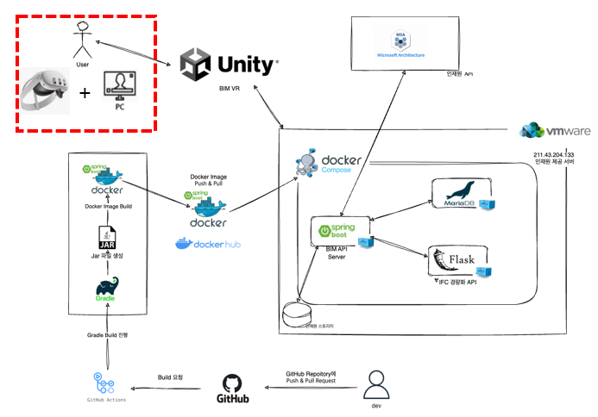
I. Verification Overview
Scope
Test Scope | 테스트 범위
Item | Meta Quest 3, PC Version
KICT-BIM Based Collaboration Platform - XR Based | Microphone Model Adjustment Parameter Adjustment Issue Registration Issue List Object List Map List View Members Navigation Zoom Position Coordinates (x, y, z)
 | COBIM Digital Collaboration Platform Research Team
 | Project > My Project Deliverables Deliverable (CDE) > Create New > File Registration Deliverable (CDE) > Create Collaboration Room Deliverable (CDE) > Room List > End Collaboration Message Notification
<System Concept Diagram>
<검증 범위>
Special Notes
No Special Notes.

Slide 6
I. Verification Overview
Quality Objectives
No. | Quality Attribute | Evaluation Item | Target Value | Evaluation Criteria (Acceptance Criteria) | Evaluation Details
1 | Functional Suitability | Completeness of Function Implementation | 100% | Implementation of all requirements specified in the Requirements Specification | Implemented functions / Specified requirements functions
2 | Portability | Ease of Installation | 100% | Degree of effectiveness and efficiency in installing or removing the KICT-BIM application in the designated environment | Number of failures / Number of successes
3 | Security | Authentication Method | 100% | Number of login authentication test cases for the KICT-BIM application | Number of executed login authentication test cases / Total number of login authentication test cases
4 | Reliability | Test Coverage | 100% | Number of executed test cases during the test period | Number of actual executed test cases / Total number of test cases

Slide 7
I. Verification Overview
Test Environment
Category | Details
Product Name | KICT-BIM Development Server
Execution Environment | - VMWare (211.43.204.133) - Software (SW): • Spring Boot : 3.2.3 • Flask : Python 3.12.4, Flask 3.0.3 • MariaDB : 11.3.2-MariaDB-1:11.3.2+maria~ubu2204 • Docker : version 25.0.4, build 1a576c5 • Docker Compose : version v2.24.7
Product Information (Description) | BIM-based collaboration platform - XR-based development (voice communication, parameter measurement, issue registration & sharing, location sharing, etc.)
Product Name | Meta Quest 3
SoC | Snapdragon XR2 Gen 2
DRAM | 8GB
Storage | 128GB
Display Resolution | 2064 x 2208 | 1218PPI | 25PPD
FOV (°) | Horizontal 110° / Vertical 96°
Lens Technology | Pancake Lens, Continuous IAD
Color Space | sRGB 100%
Battery | 5060mAh ~22 hours continuous

Slide 8
I. Verification Overview
Test Environment
Product Name | PC
OS | Windows 10 Pro
Processor | Intel(R) Core(TM) i7-1195G7 CPU @ 2.90GHz 2.92 GHz
RAM | 16.0GB

Slide 9
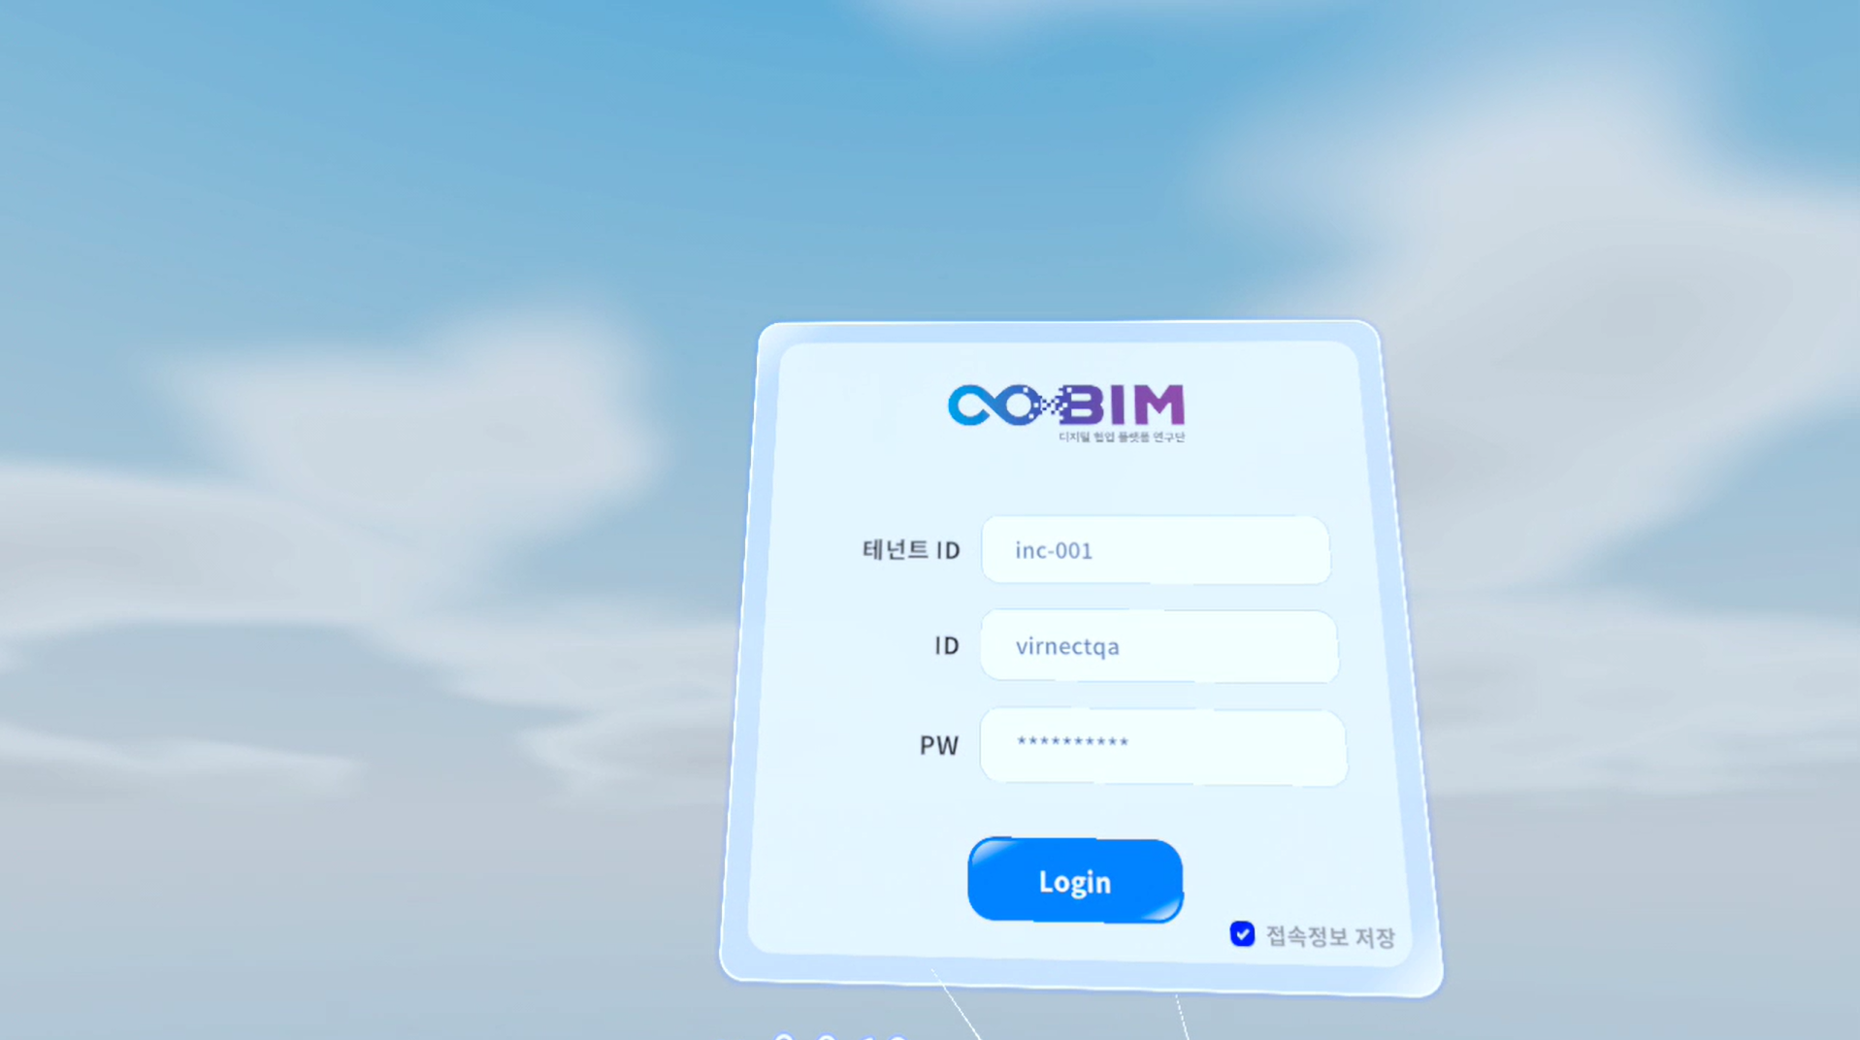
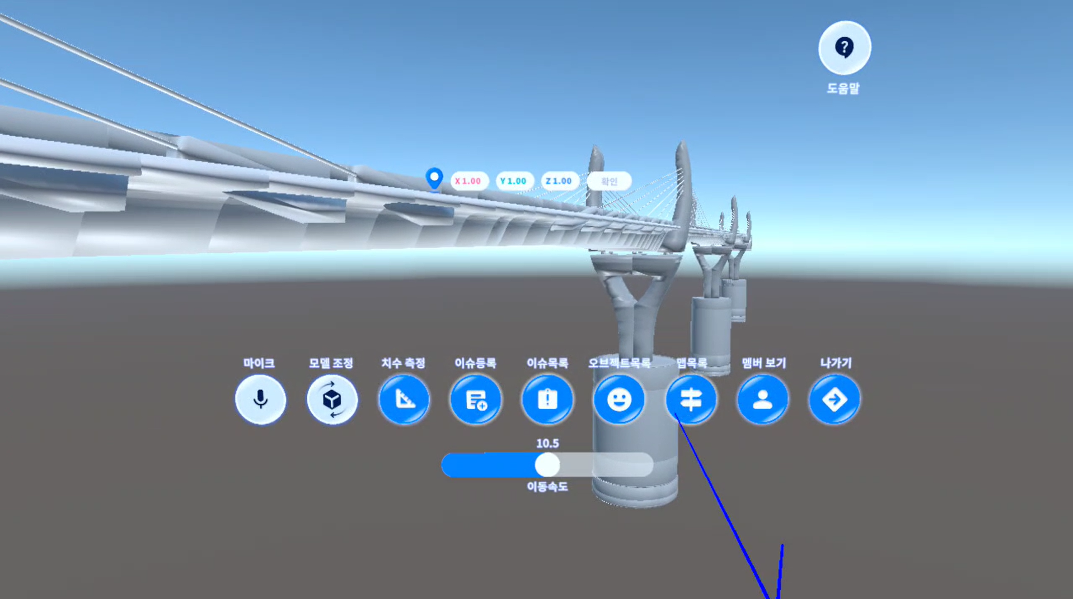
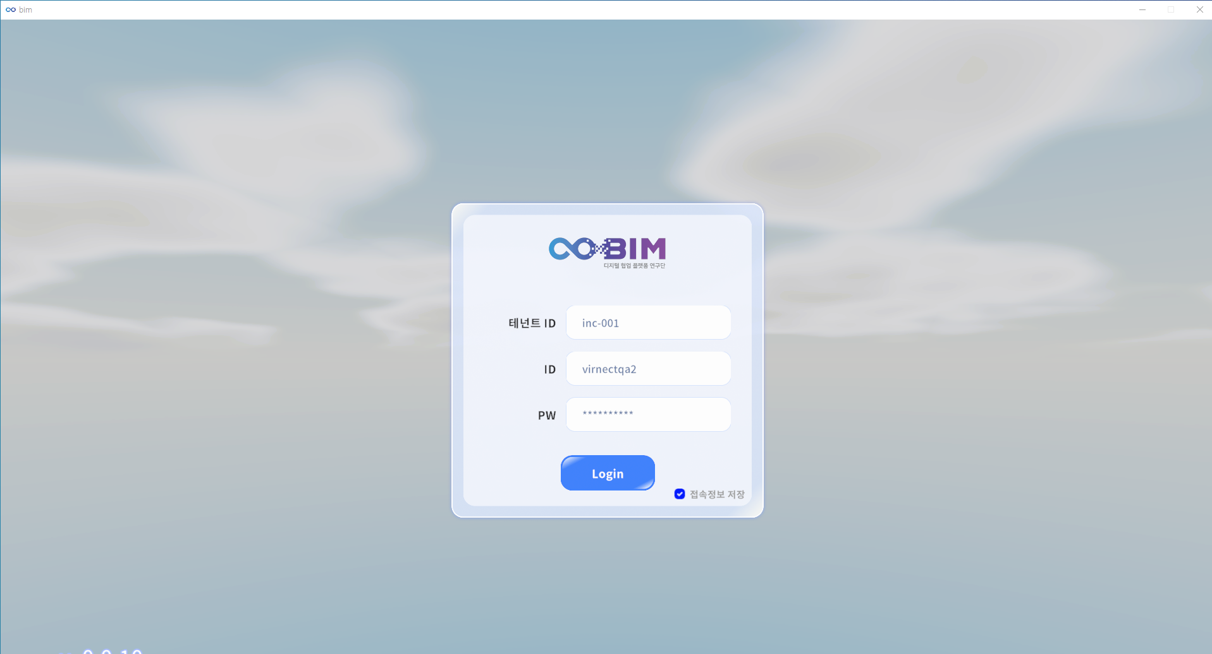
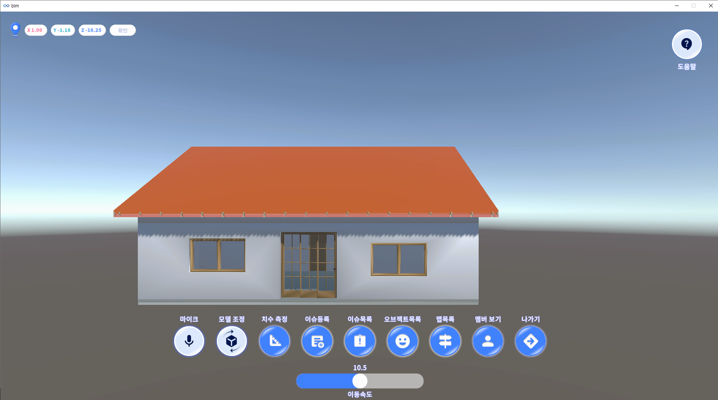
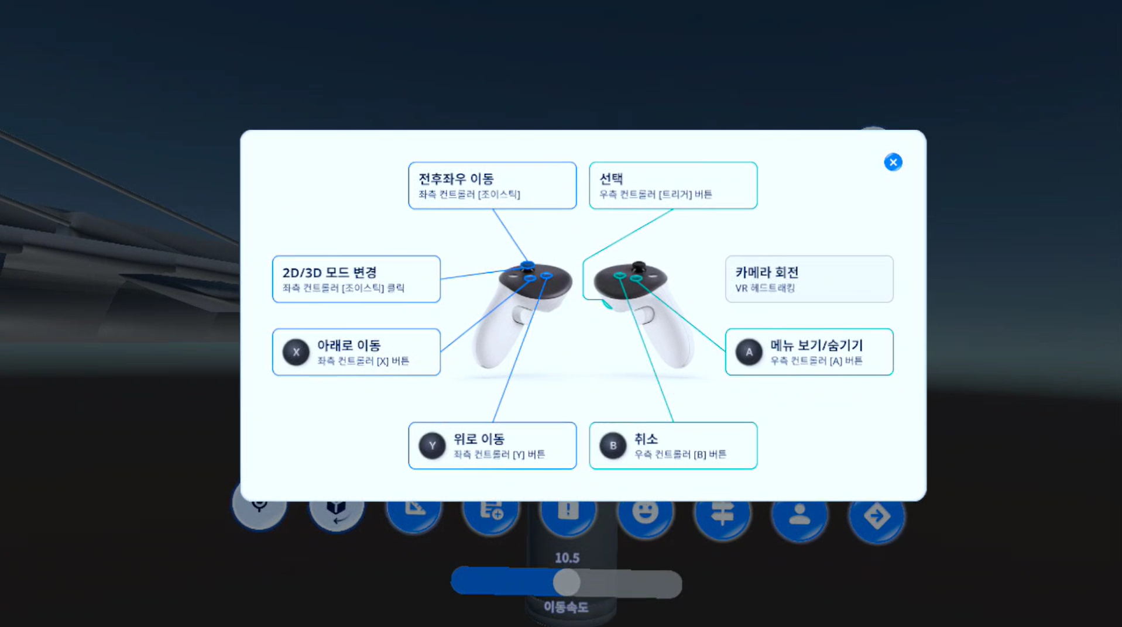
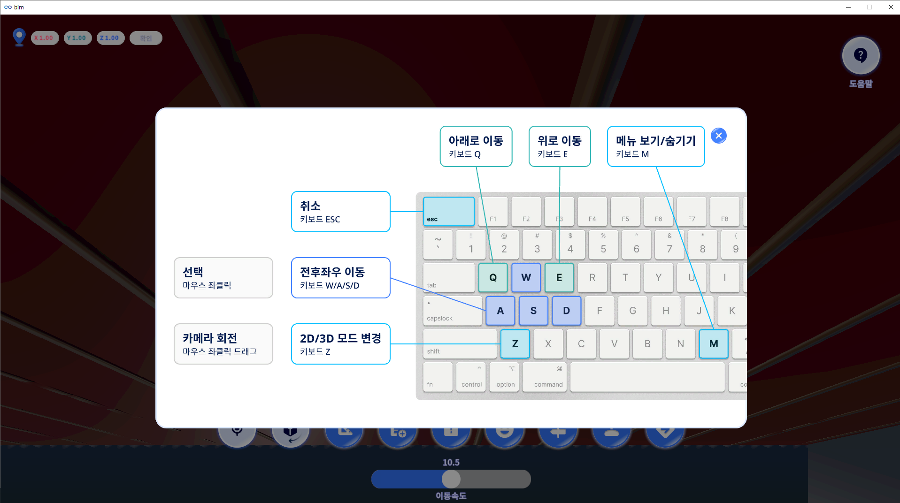
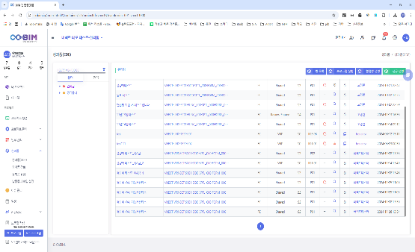
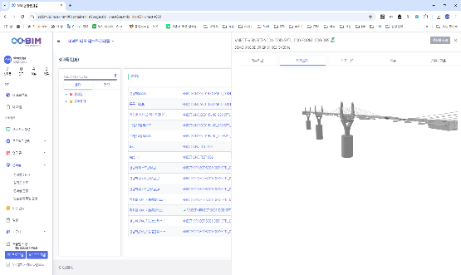
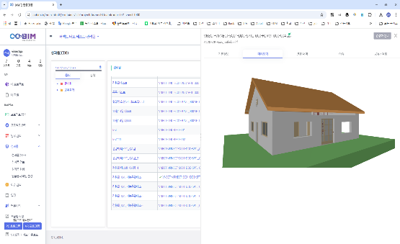
I. 검증 개요
Test Environment
<KICT-BIM Metaquest3>
<KICT-BIM PC>
<cobim((https://cobim.io)>

Slide 10
II. Verification Results
Quality Evaluation
The final quality verification was conducted based on the 2024 goals specified in the Requirements Specification and Business Plan. All quality objectives for the 2024 quality attributes have been achieved.
Exceeded Expectations
Goal Achieved
Not Achieved
No. | Quality Attribute | Evaluation Item | Target Value | Evaluation Criteria (Acceptance Criteria) | Evaluation Details | Evaluation Result
1 | Functional Suitability | Completeness of Function Implementation | 100% | Implementation of all requirements specified in the Requirements Specification | MetaQuest3 - Upper-Level Functions: 24 MetaQuest3 - Lower-Level Functions: 37 PC Version - Upper-Level Functions: 20 PC Version - Lower-Level Functions: 42
2 | Portability | Ease of Installation | 100% | Degree of effectiveness and efficiency in installing or removing the KICT-BIM application in the designated environment | 0 installation failures / 30 successful installations & removals
3 | Security | Authentication Method | 100% | Number of login authentication test cases for the KICT-BIM application | MetaQuest3: 3 / 3 PC Version: 3 / 3
4 | Reliability | Test Coverage | 100% | Number of executed test cases during the test period | MetaQuest3 - Functional (Unit) Test Cases: 54 PC Version - Functional (Unit) Test Cases: 59 COBIM - Digital Collaboration Platform Functionality (Integrated) Test Cases: 21

Slide 11
II. Verification Results
Summary of Results
1. Based on the business plan, comprehensive test plan, and requirements specification, a total of 134 test specifications were created for functional (unit) and functional (integration) tests:
MetaQuest3 Functional (Unit) Tests: 54 cases
PC Version Functional (Unit) Tests: 59 cases
Cobim + MetaQuest3 + PC Version Application Functional (Integration) Tests: 21 cases
2. All defects identified in the functional (unit) and functional (integration) tests were fixed and regression testing was conducted.
3. The VIRNECT KICT-BIM-based collaboration platform achieved its quality objectives in functional suitability, portability, security, and reliability, confirming "Goal Achieved."
Verification Findings
Functional (unit) and functional (integration) tests were conducted based on the RTM (Requirements Traceability Matrix).
Functional (integration) testing was conducted under a scenario where the Cobim platform interacted with the Meta Quest 3 and PC version applications. Users participated in the same collaboration room to test voice communication, model adjustments, parameter measurements, issue sharing, and spatial information sharing.
During verification of implemented requirements and operation, no critical issues were found.

Slide 12
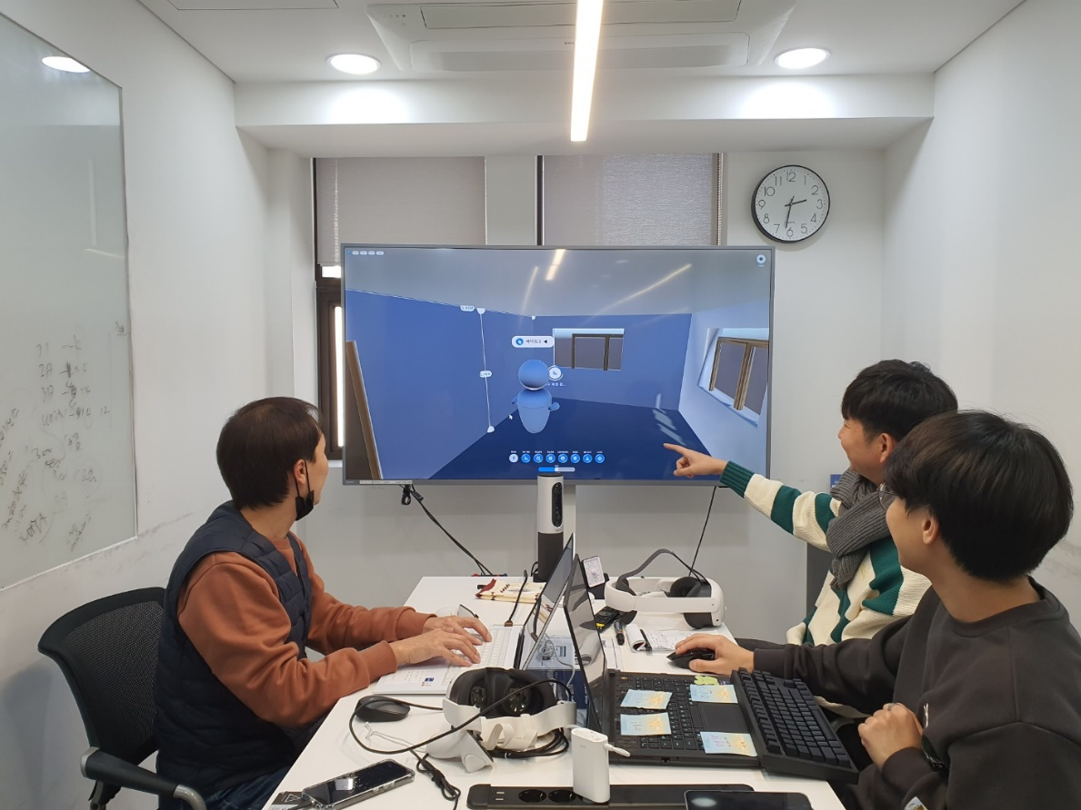
III Appendix: Quality Verification Execution Environment
Verification Location
Seoul, VIRNECT
Verification Target
KICT-BIM Based Collaboration Platform - XR Based
<Quality Verification Product Test Environment>

Slide 13
Thank you.

